Slide 1
Integrated EM-KPI Ontology for District and Building Energy Performance Analysis
Li Yehong (liyehong_070426@hotmail.com)
Supervisor: Sergio Vega-Sánchez
Co-Supervisor: Raúl García-Castro
Notes:
Assessment of District Building Energy Management in Smart City via KPIs-based Linked Data

Slide 2
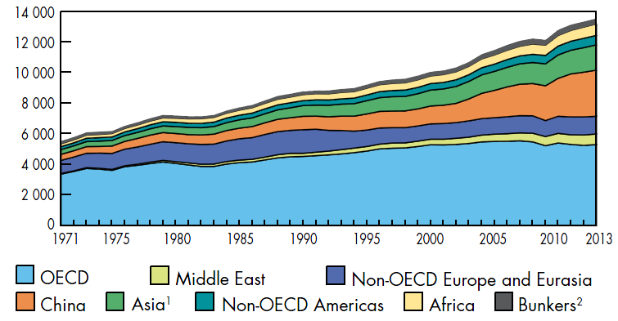
Energy issues
Source: International Energy Agency (IEA)

Slide 3
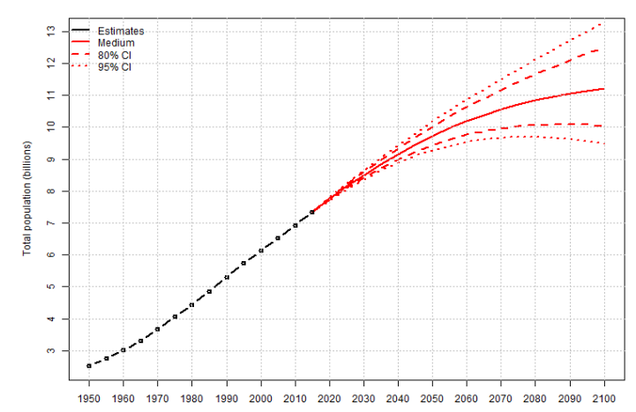
Urban issues
Rapid urbanization:
Urban population reached 50% by 2008
Greater than 75% in most of the developed countries by 2040
50%-75% in developing countries like China by 2040
Additional pressure on cities:
Energy and resources shortages
Inadequate and deteriorating infrastructure
Environmental concerns
Source: World Population Prospects: The 2015 Revision, United Nations
Source: Unicef

Slide 4
Smart City and Community Initiatives
FP7-SMARTCITIES-2013:
E-balance project, smart energy management
R2CITIES, 15 cities and communities, “My Smart City District”
CONCERTO for building and district energy efficiency innovation
European Horizon2020:
Smart Cities & Communities: Low energy district
Digital Agenda for Europe
European Innovation Partnership on Smart Cities and Communities

Slide 5
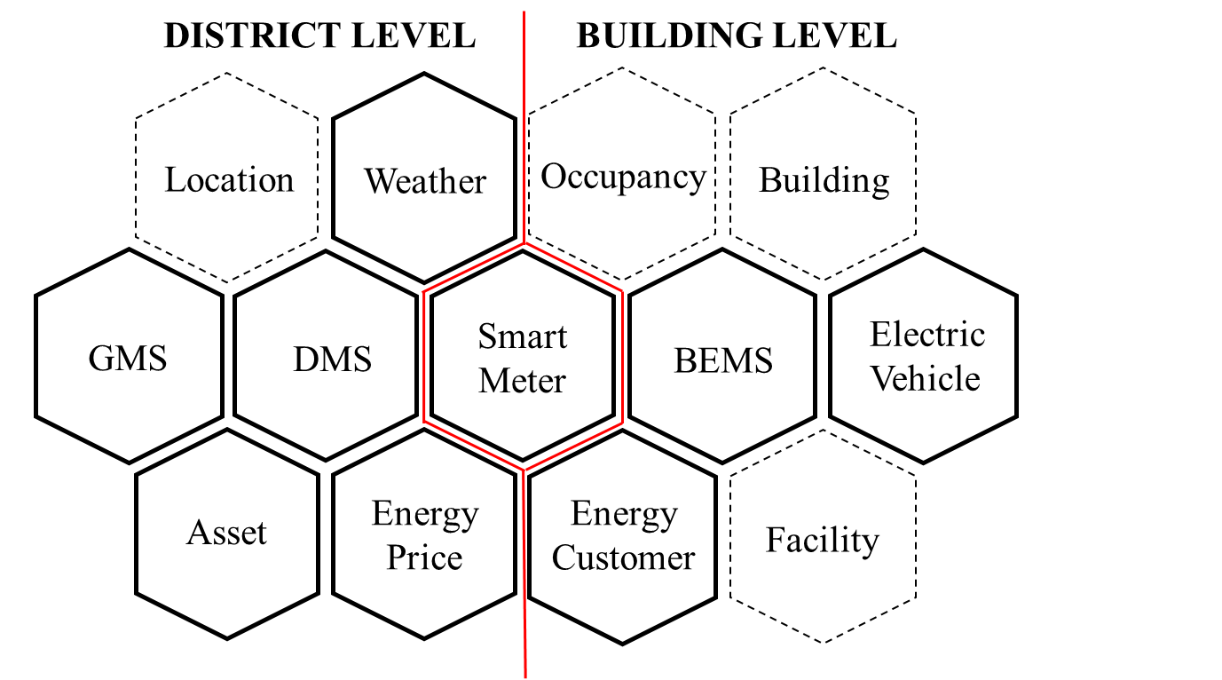
Information-driven energy management
Integration of district and building
Interaction between supply side and demand side: Demand Side Management
Information sharing between energy-related multi-domains
Challenge in addressing multi-level energy efficiency

Slide 6
Opportunities and Challenges in Generated Big Data
Opportunities:
New analysis possibility – Data-driven decision
Insights in potential energy performance improvement
Massive data generation
New management needs
New hard and soft systems
New analysis possibility
Challenges:
How to choose the ¨master data¨ and make sense of it
Cross-domain data interoperability
A structured approach to ensure the data analysis address stakeholders´ energy performance goals
Notes:
With the implications of data from smart grids, energy cost could save up to $2 trillion by 2030, according to the National Institute of Standards and Technology (NIST).
DEM is complex process where various stakeholders involved in. The first-hand energy data from different domains are handled by different stakeholders. In order to facilitate the data sharing, data reuse in DEM should aim to address the stakeholders’ key performance concerns.

Slide 7
A structured approach for energy performance analysis
Task1 - Integrated energy management context analysis
Subtask 2.1 – Identify internal stakeholders
Task 2 - Identify stakeholders´ role
Energy review:
Energy structure
Energy system
Energy flow
Subtask 2.2 – Identify external stakeholders
Task 3 - Analyze stakeholders´ concerns
Task 4 - Identify and Select Required KPIs
Subtask 5.1 - Review Existing data capture
Task 9: Take improvement initiatives
Task 5 – Identify and collect Master Data
Subtask 5.2 - Determine future data capture
Task 6 - Linked Data generation
Subtask 6.1 - Define EM-KPI ontology
Task 8: Identify performance problems
Task 7 - KPIs calculation and assessment
Subtask 7.1 - KPI Benchmarking
No
Target
performance
Subtask 7.2 - KPI Baselining
Yes
Final Task - Objective achived and experience study
Notes:
the Key Performance Indicators (KPIs) that underpin the stakeholders’ performance concerns

Slide 8
Dimension of KPIs at multi-level

Slide 9
Relationship between Master data and KPIs
KPI representation
Energy performance tracking and assessment
Energy processes analysis
00
Master data domains
Stakeholders´ performance goals
Master data objects
Performance objects
Master data elements
Key Performance Indicators
Formula
Datum sources
Master data representation
Energy performance problem identification and informed decision making in improvement
Reference: J. O’Donnell, et al., “Scenario Modelling: A Holistic Environmental and Energy Management Method for Building Operation Optimization,” Energy Build., vol. 62, no. July, pp. 146–157, 2013.
Notes:
the result of the EM-KPI Ontology can provide timely information for key performance tracking, exchange data and key performance information between stakeholders, and help to analyze energy performance problem.
the integrated EM-KPI ontology that could exchange both data and key performance information and help analyze energy performance problems, so as to improve energy performance both in district and building level.

Slide 10
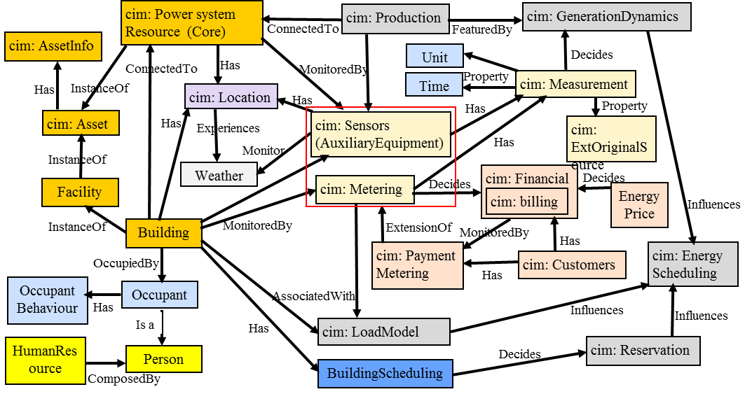
Ontology Conceptualization: Initial model
KPI Ontology
NeOn: Network of Ontologies
Strategic KPIs
Calculation formula
Measurement data
Tactical KPIs
Entity info, Asset, Facility
GMSGeneration)
DMS(Distribution)
CIS(Customer)
ERP(Financial)
Sensor, meter and its monitored data (from SCADA, BEMS)
HR(Human)
Notes:
Regarding to the utility grid data, profiles and extensions of Common Information Model(CIM) [5][6] is used to describe the information like power system resources, production and generation dynamic, district load model.

Slide 11
CIM as an Ontology
CIM: Common Information Model
IEC 61970-501 | TC 57 | Energy management system application program interface (EMS-API) - Part 501: Common Information Model Resource Description Framework (CIM RDF) schema | AMI | DA | DER | DMS | DR | EMS
IEC 61968-13 | TC 57 | Application integration at electric utilities - System interfaces for distribution management - Part 13: CIM RDF Model exchange format for distribution | AMI | DER | DMS | DR

Slide 12
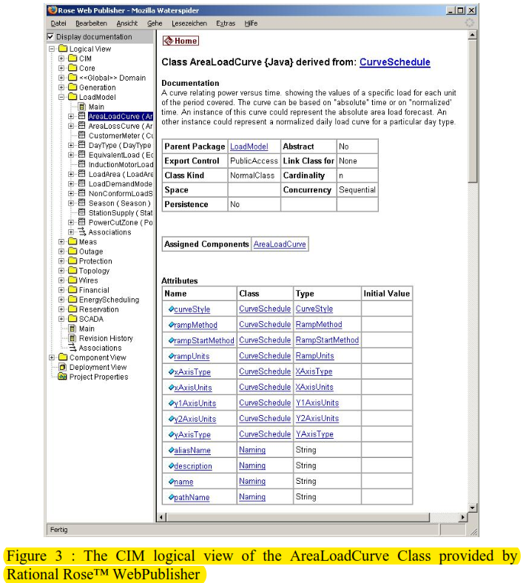

Slide 13
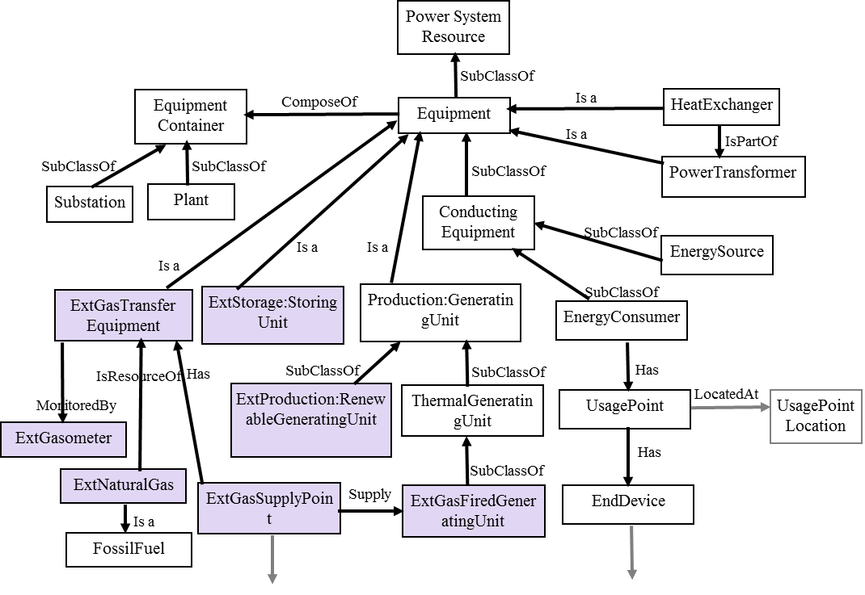
cim: power system resource

Slide 14
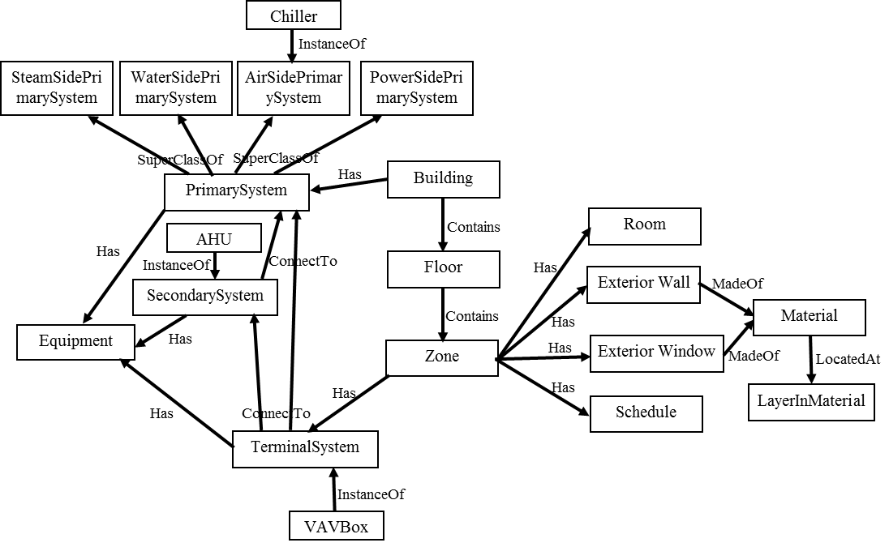
Initial model: building
Reference: Bing Dong, Zheng O’ Neill, Zhengwei Li, “A-BIM based information infrastructure for building energy fault detection and diagnostics, Automation in Construction, Volume 44, August 2014, Pages 197–211

Slide 15
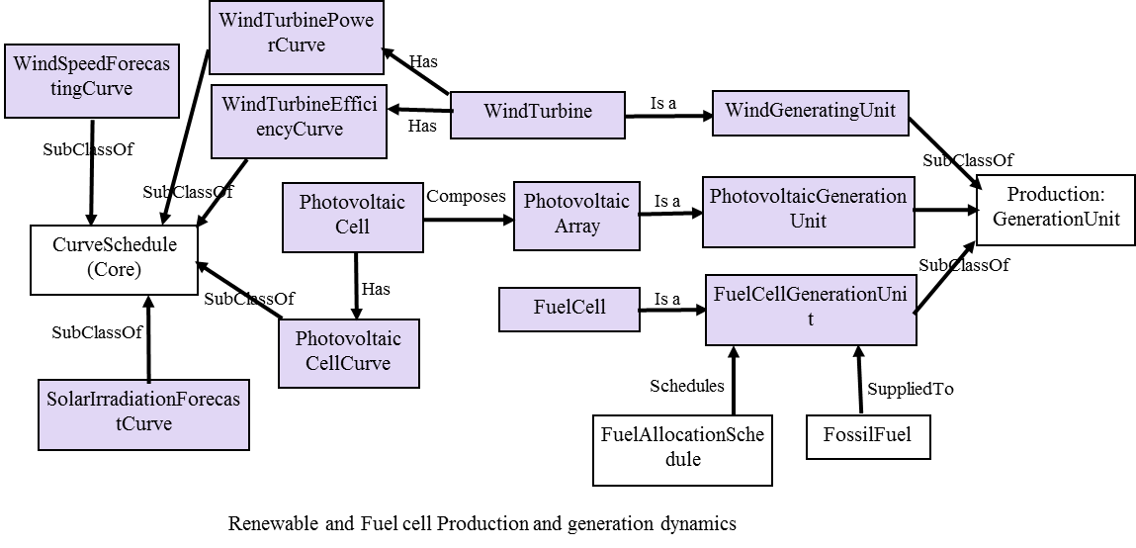
cim: production and generation dynamic
Reference: Ming Ding, et al., CIM Extension of Microgrid Energy Management System, 2009 Asia-Pacific Power and Energy Engineering Conference, March 2009

Slide 16
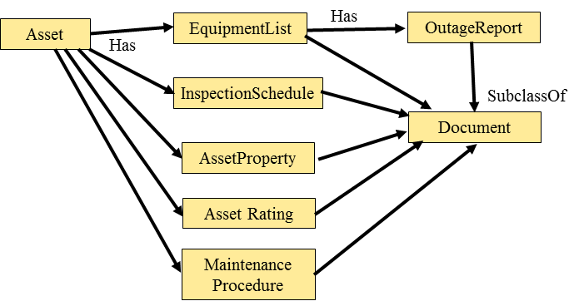
Initial model: measurement, unit and time
Other ontologies reuse:
Location,
Weather,
Occupant,
Human resources,
etc.
Scalability of the NeOn

Slide 17
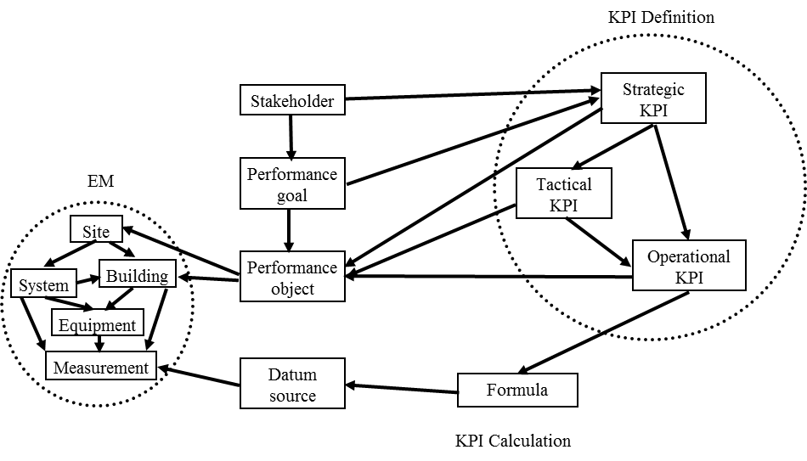
Initial model: KPIs
Reference: Emanuele Caputo, et al., KPI Modeling in MDA Perspective, 2010
E. Corry, P. Pauwels, S. Hu, M. Keane, and J. O’Donnell, “A performance assessment ontology for the environmental and energy management of buildings,” Autom. Constr., vol. 57, pp. 249–259, 2015
Notes:
The key performance information is what concerned by stakeholders. Emergent district energy management is aimed for the interaction between stakeholders[8]. The KPI ontology is supposed to represent the hierarchy of KPI (i.e. strategic, tactical and operational), the performance object of KPI, the calculation formula of KPI and the Datum needed for the calculation.

Slide 18
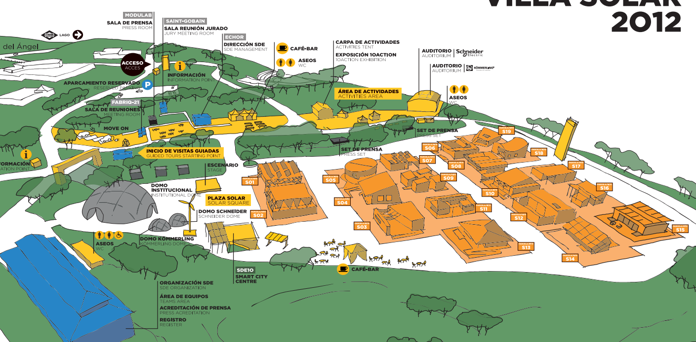
Validate with Real Scenario SDE2012
19 prototype of solar houses with building integrated PV, innovated energy efficiency measures, Connected to a smart microgrid, two weeks 15-minute interval monitoring of all the buildings and systems, energy consumption data, energy generation data, indoor comfort and outdoor data, occupancy data, also building construction information.
Notes:
Further work will focus on the implementation of the EM-KPI Ontology

Slide 19
Li Yehong
Technologies Innovation and Sustinable in Buildings(TISE) Group
Architecture School, Polytechnic University of Madrid, Spain
liyehong_070426@hotmail.com

